Slide 1
台灣計算力學學會的前世今生
陳俊杉
台灣計算力學學會籌備委員會 主席
1

Slide 2
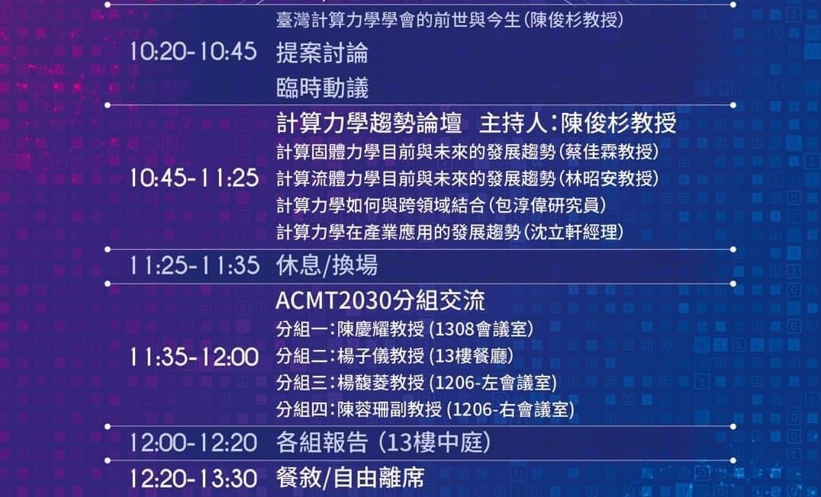
三個大哉問：我是誰、我從哪裡來，我到哪裡去？
我從哪裡來
我是誰
我到哪裡去
我到哪裡去
1

Slide 3
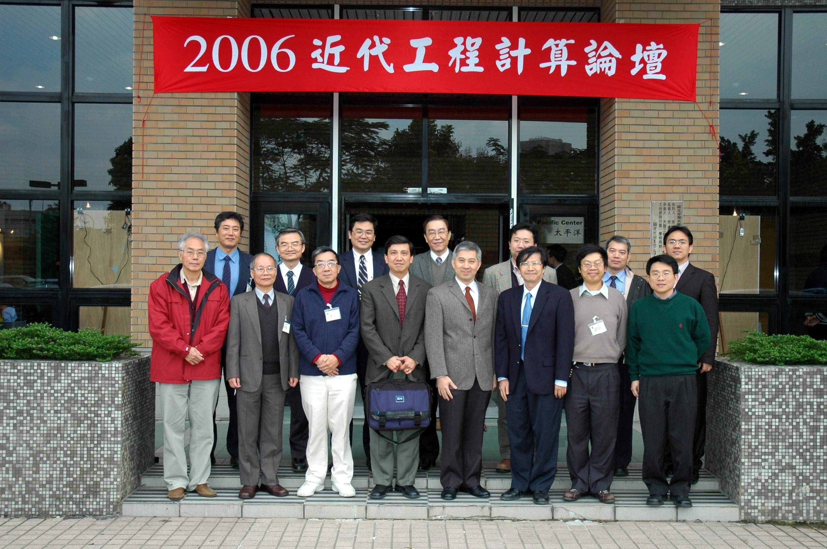
台灣計算力學學會 ACMT 大事記
Association of Computational Mechanics Taiwan (ACMT)
2006.12.21: ACMT
正式成立
籌備加入 IACM
International Association of Computational Mechanics (IACM)

Slide 4
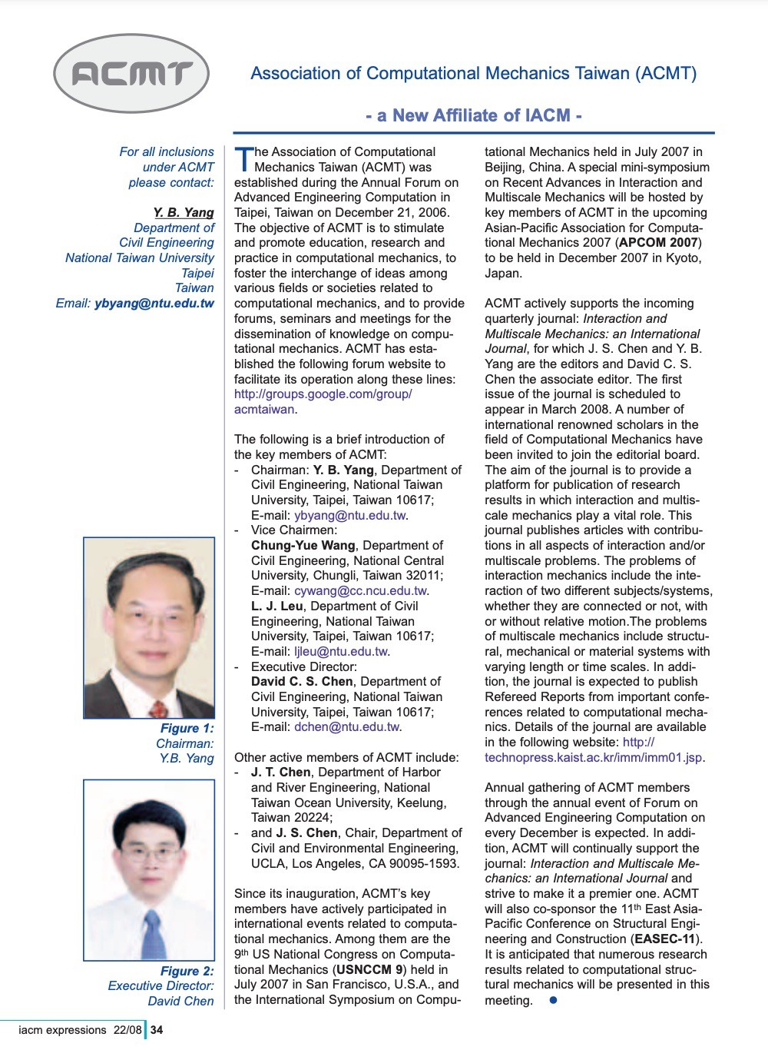
台灣計算力學學會 ACMT 大事記
2007: ACMT 正式加入 IACM，成為 IACM 的國家會員。
International Association of Computational Mechanics (IACM)
ACMT Key Members:
楊永斌 Chairman
王仲宇 Vice Chairman
呂良正 Vice Chairman
陳俊杉 Executive Director
陳正宗 Active Member
4

Slide 5
International Association of Computational Mechanics (IACM)
The largest computational mechanics community to promote advances in computational mechanics by the international group of scholars and practitioners of this new discipline.
Founded in 1981
Affiliated Associations (national and regional)
Currently: 33 Associations
More than 5,000 members
The General Council (nominated by Affiliated Associations)
The Executive Council
In charge of managing scientific, technical and financial affairs
17 members + Officers
5

Slide 6
台灣計算力學學會 ACMT 大事記
2007 – now 積極參加 IACM 相關國際會議
World Congress on Computational Mechanics (WCCM) organized by IACM (every two years)
US National Congress on Computational Mechanics (USNCCM) organized by USACM (every two years)
Asia-Pacific Congress on Computational Mechanics (APCOM) organized by APACM (every three years)
European Congress on Computational Methods in Applied Sciences and Engineering, organized by ECCOMAS (every two years)
IACM CFC, IACM Mechanistic Machine Learning and Digital Twins for Computational Science, Engineering & Technology
IACM, APACM, USACM, ECCOMAS Thematic Conferences
5

Slide 7
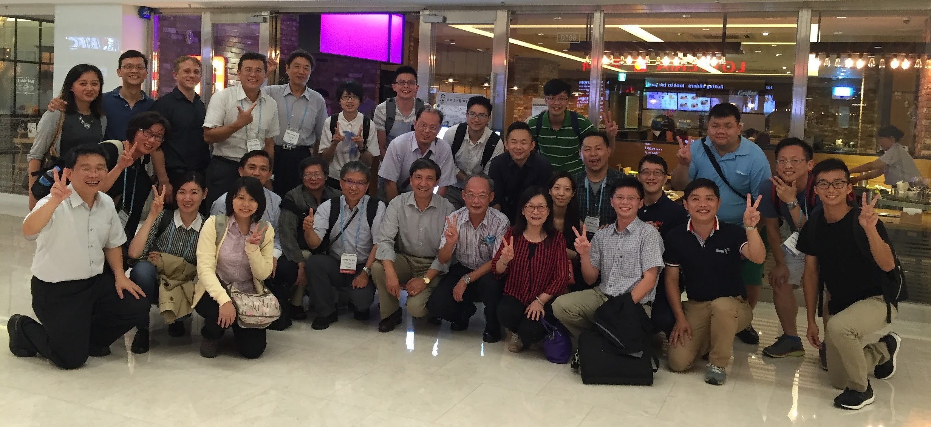
WCCM-APCOM 2016, Seoul
7

Slide 8
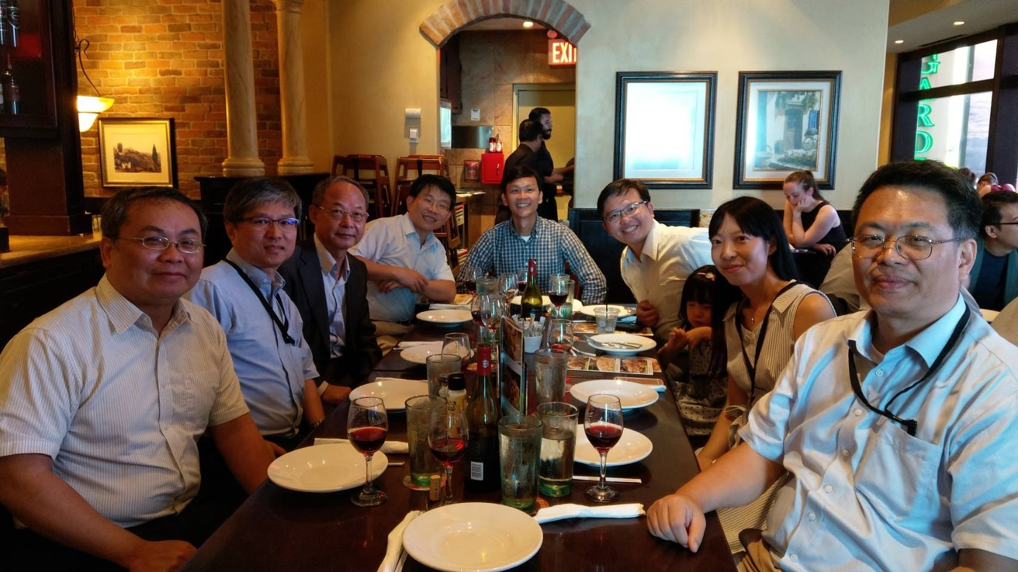
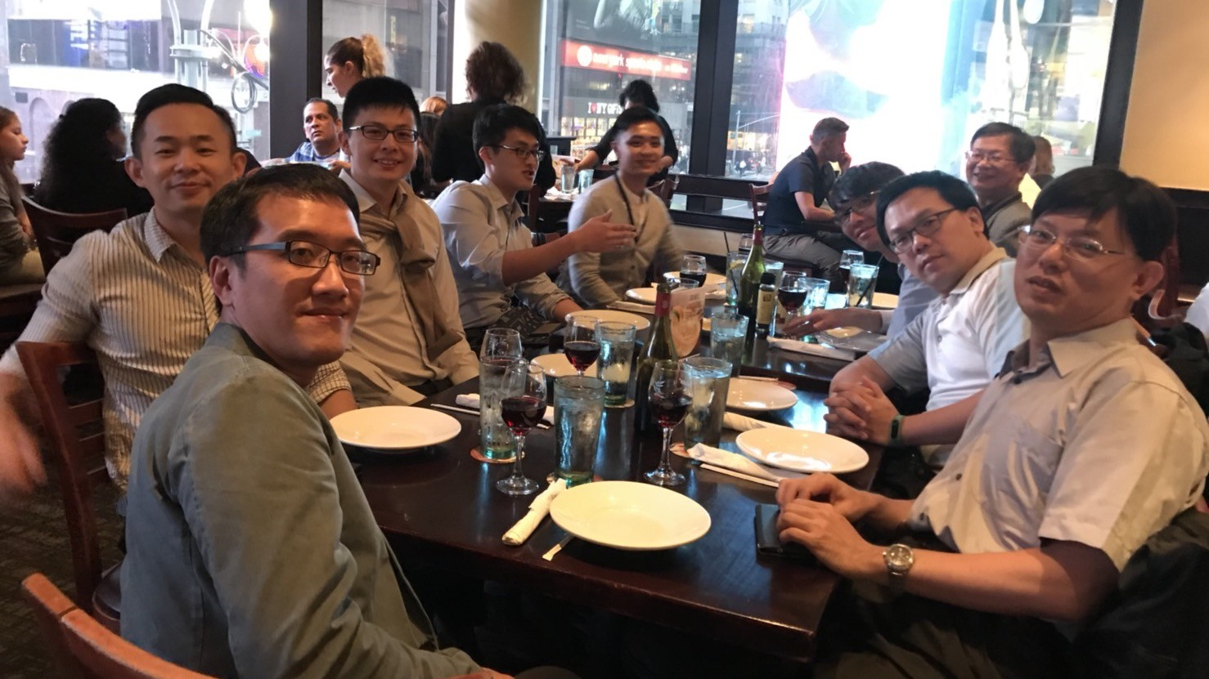
WCCM 2018, NYC

Slide 9
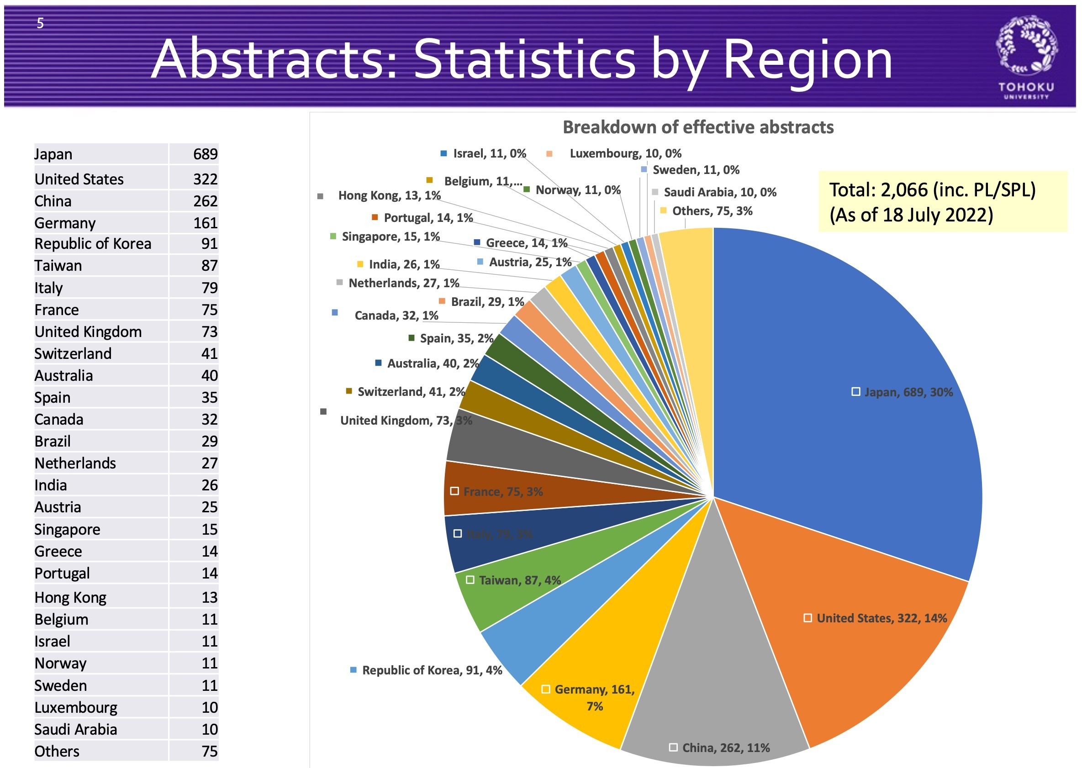
WCCM-APCOM 2022

Slide 10
Save the date! WCCM 2024
21-26 July 2024, Vancouver, Canada

Slide 11
台灣計算力學學會 ACMT 大事記
2015 – now 積極主辦相關國內與國際計算會議
ACMT 2015, Taipei
ACMT 2017, Tainan
APCOM 2019, Taipei
ACMT 2016, Taipei
ICM 2018, Yilan

Slide 12
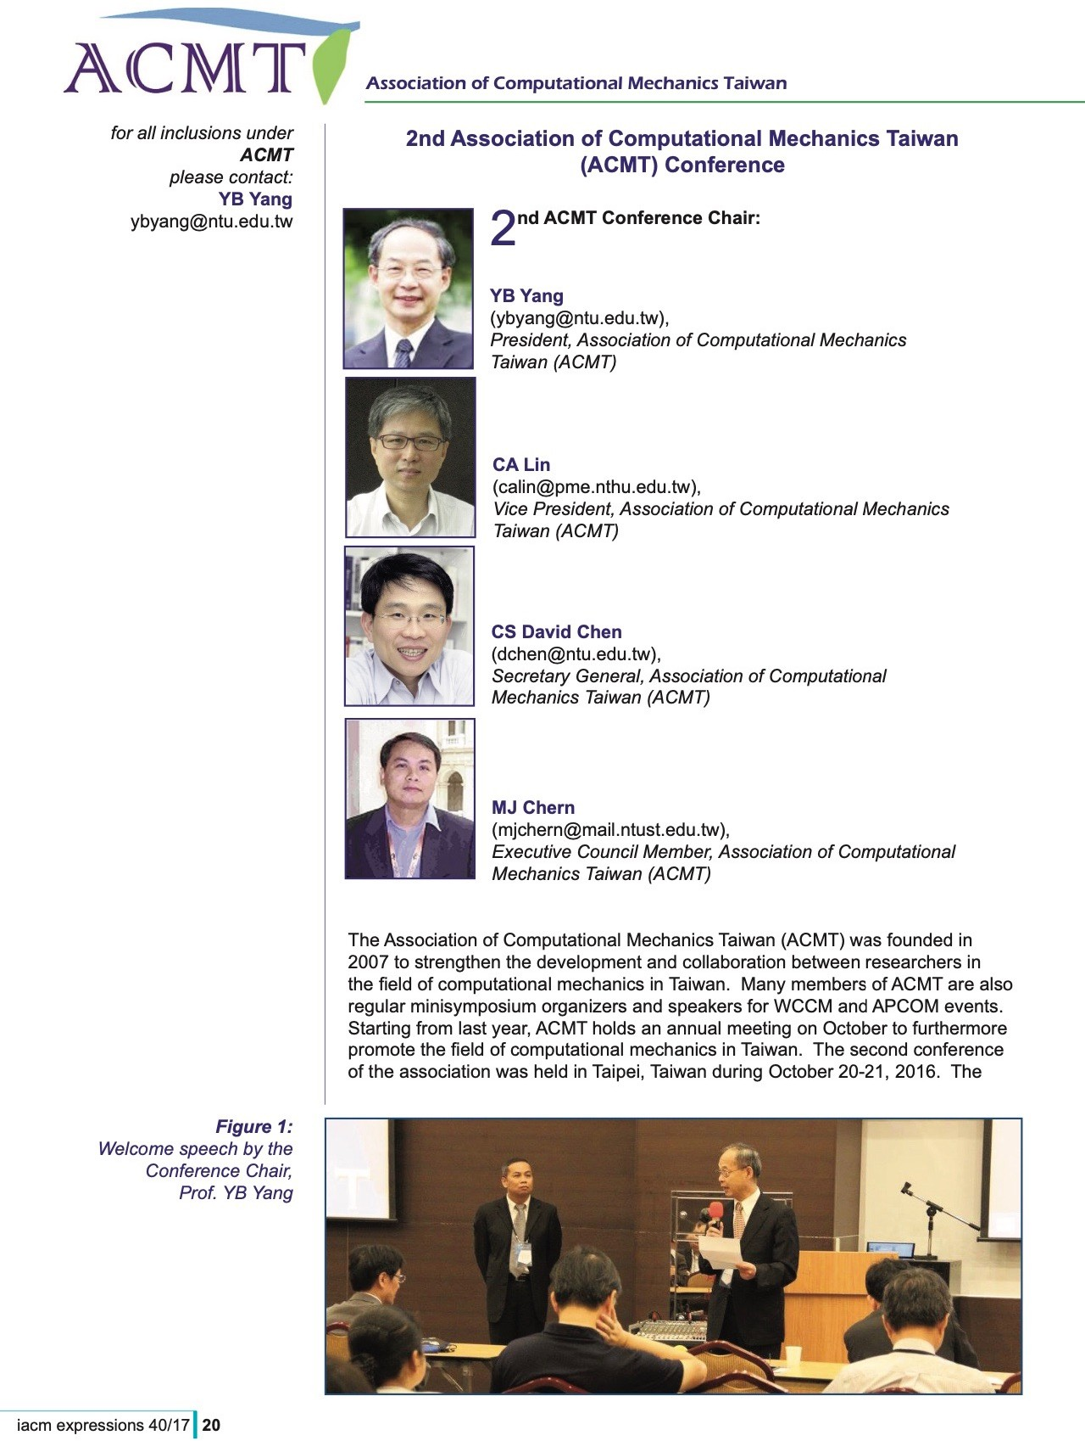
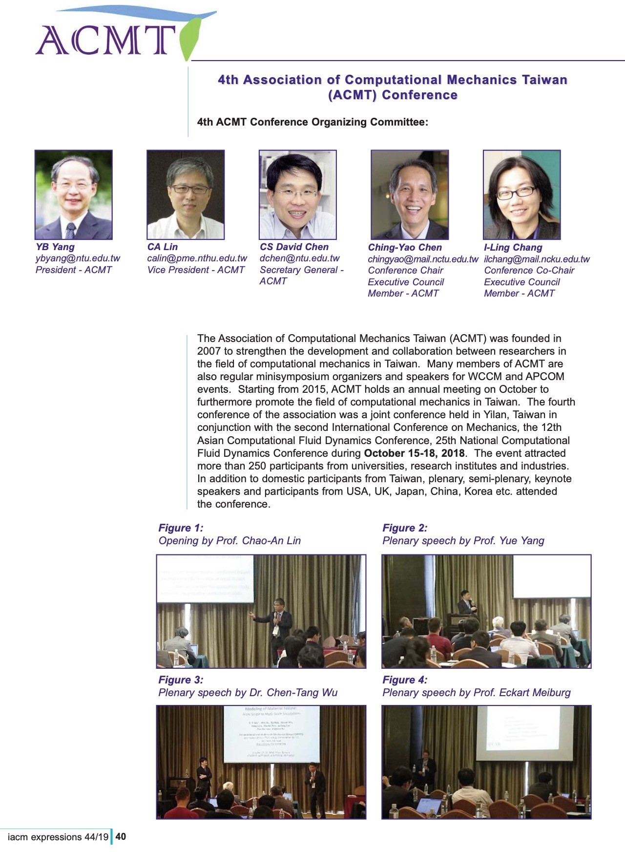

Slide 14
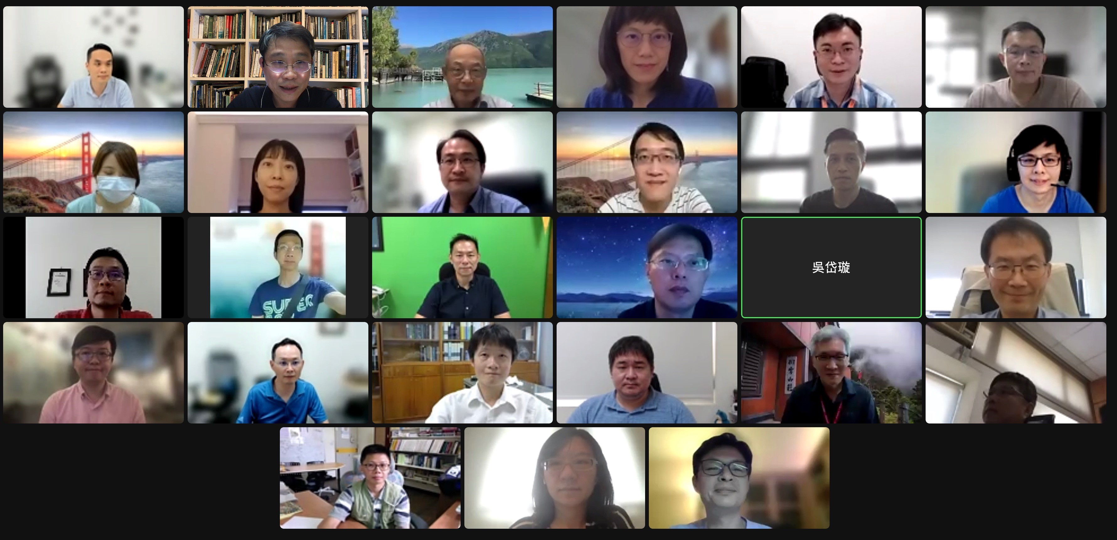
台灣計算力學學會 ACMT 大事記
2022 正式向內政部成立台灣計算力學學會
2022.06.20 發起人會議暨第一次籌備會議

Slide 15
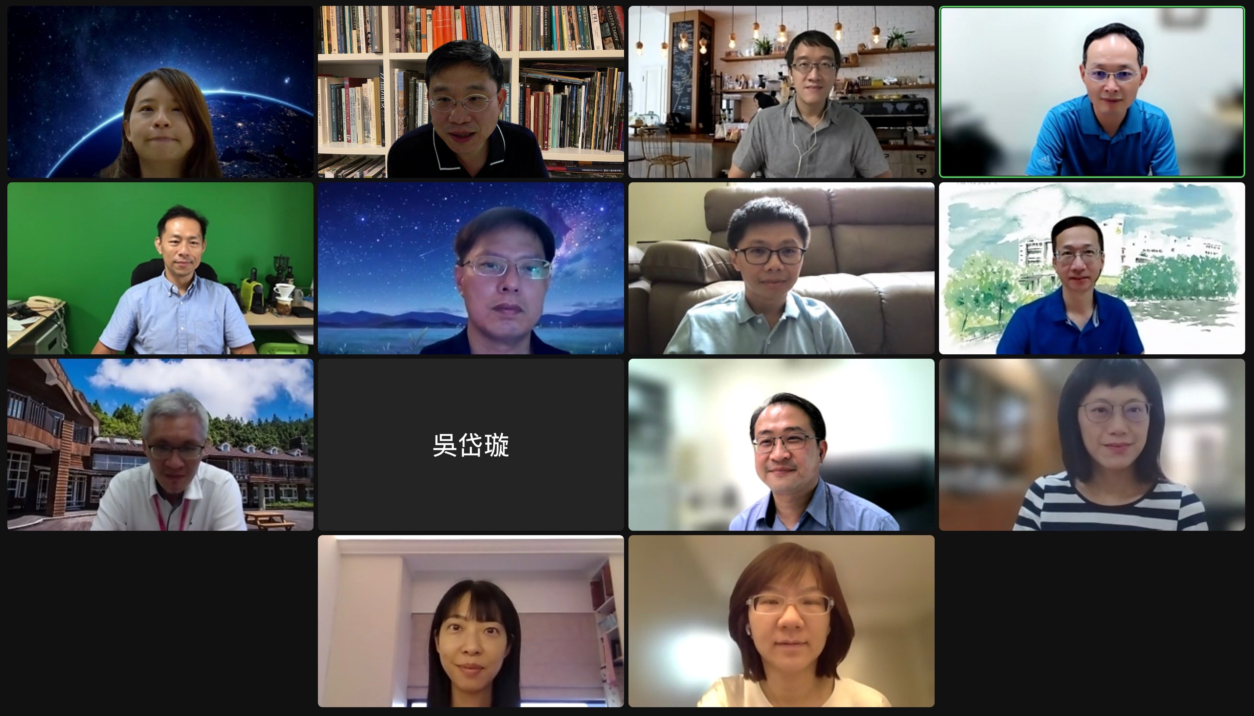
台灣計算力學學會 ACMT 大事記
2022 正式向內政部成立台灣計算力學學會
2022.08.31
第二次籌備會議

